Slide 1
Self Introduction
TRAINING SESSION ON POWER POINT

Slide 2
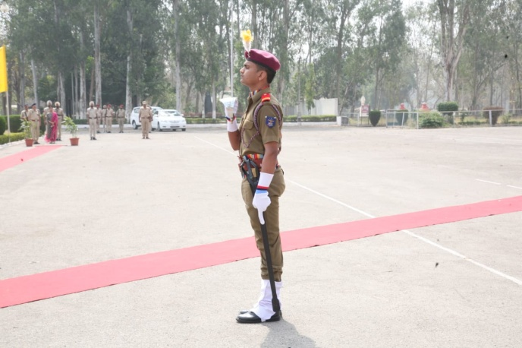
PROFILE
Name : Akshit Mangotra
Date of Birth: 23rd August 2000
Age: 18
Branch and Course: Computer science, B.Tech
University Roll no: 1807598
Semester: 3rd
Class roll no: 306
AIM: To become an IAF Fighter Pilot

Slide 3
CHOICE
OF
LIFE
DISLIKES
Shopping
Abusing
Interfering in useless discussions
LIKES:
Reading books
Writing poems
Listening songs
Enhancing facts about general knowledge
Playing hockey
Sleeping

Slide 4
*Writing Poems *Software developing *Defence inclination issues *WEB DESIGNING *EXPLORING ABOUT WORLD ISSUES
Domains Of Interest:

Slide 5
Family Love:
FATHER:
My father’s name is Mr. Surinder Kumar.
He works as an Account officer at NFL Bathinda.
MOTHER:
My mother’s name is Mrs. Sunita
She is a Math's Teacher at Government Senior Secondary School.
SISTER:
My sister’s name is Amrita Mangotra.
She is perusing Banking sector coaching.

Slide 6

Alma mater:
I’ve done my schooling form Sainik School Kapurthala.
It’s situated in the provinces of the Palace of Maharaja Jagatjit Singh.
There is only one Sainik School in Punjab and it is situated in Kapurthala.
Total there are 25 Sainik Schools placed across our country.

Slide 7
College: MIMIT
Malout Institute of Management and Information Technology
It is a premier institute situated in Malout, Muktsar.
It is affiliated under Government of Punjab.
It offers various courses of B.Tech ,BCA,BBA and MBA.

Slide 8
Achievements And Credits :
I Secured 9.4 CGPA in class 10^{th.}
Stood first North Zone English Debate Competition.
Captained Both in North Zonal and All India Inter zonal Inter zonal Sainik School Hockey Tournament .
Stood First in North Zone Hockey Tournament.
Appointed as School NCC Captain.
Stood 2nd in Best Cadet Competition in P H HP CHD Directorate.
Participated in Inter College Debate Competition.

Slide 9
Inspirations in Various fields:
My Father
Dr.APJ Abdul Kalam
Cristino Ranaldo
Arc Hades
Lt Gen Ranbir Singh

Slide 10
Abode : Bathinda
Bathinda also knows as the “City of Lakes” is a historic place of Punjab.
It is situated in the Malwa region of Punjab.
Its one of ancient build city earlier knows as “Bathilanda”.
This city stood First at Swatch Bharat Abhiyan Survey Across the Punjab.
It has a population of 285,813 people per unit area.
It has the largest railway junction in the Asia.

Slide 11
Places to visit:
It has a great ancient Qila of Queen Razia Sultan where she was captured by Rulers Delhi Sultanate
It has a holy pilgrimage Gurudhwara situated at Qila.
It has 4 Malls situated and 2 lakes to visit for its beauty
A great Source of thermal energy.
A National Fertilizers Limited Factory for the production of Urea and fertilizers.
It has various parks and grounds like Joggers park and Chetak Park.

Slide 12
Inspiring quotes:
Sleep with Satisfaction and wake up with Determination

Slide 13



Thank you

